Slide 1
Requirements Engineering
Instructor: Mehroze Khan

Slide 2
Requirements Engineering
The requirements for a system are the descriptions of the services that a system should provide and the constraints on its operation.
These requirements reflect the needs of customers for a system that serves a certain purpose such as controlling a device, placing an order, or finding information.
The process of finding out, analyzing, documenting and checking these services and constraints is called requirements engineering (RE).

Slide 3
Requirements Engineering Tasks
Inception
Elicitation
Elaboration
Negotiation
Specification
Validation
Management

Slide 4
Requirements Engineering Tasks
Inception: understand problem, people, nature of solution, effectiveness of communication.
Elicitation: Ask questions about objectives, targets, detailed requirements
Elaboration: Identify software function, behavior, information. Develop Requirements Model!!! Analysis???
Negotiation: Resolve conflicts. Prioritize Requirements!!!
Specification: Write document containing requirements models, scenarios etc.
Validation: Ensure that all requirements have been stated, unambiguously!
Management: Identify, control, track requirements and changes

Slide 5
Elaboration
Analyze, model, specify…
Some Analysis Techniques
Data Flow Diagrams (DFD)
Use case Diagram
Object Models (ER Diagrams)
State Diagrams
Sequence Diagrams
Activity Diagrams

Slide 6
Requirements Modeling
Scenario-based Models
User Stories
Use Case Diagram
Class-oriented Models
Class Diagram
CRC Cards
Behavioral Models
State Diagram
Sequence Diagram
Flow-oriented Models
Data Flow Diagram

Slide 7
Use Case Diagram
Components
A large box: system boundary
Stick figures outside the box: actors, both human and systems
Each oval inside the box: a use case that represents some major required functionality and its variant
A line between an actor and use case: the actor participates in the use case
Use cases do not necessarily model all the tasks, instead they are used to specify user views of essential system behaviour

Slide 8
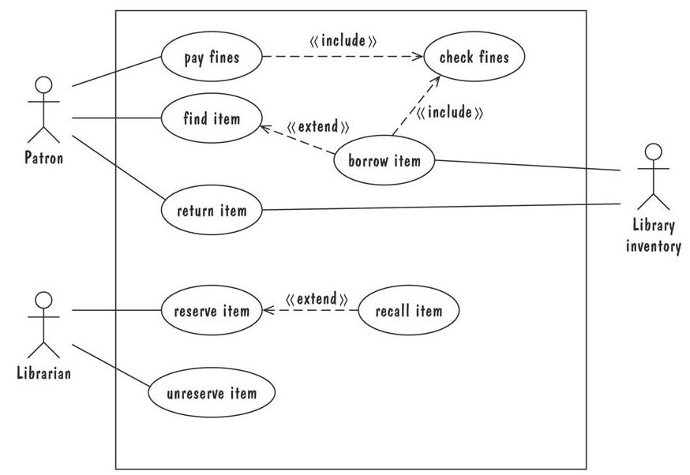
Use Case Diagram

Slide 9
Entity Relationship Diagram
ER Model is used to model the logical view of the system from a data perspective.
It consists of following components:
An entity: depicted as a rectangle, represents a collection of real-world objects that have common properties and behaviours.
A relationship: depicted as an edge between two entities, with diamond in the middle of the edge specifying the type of relationship.
An attribute: represented as an oval, describes data or properties associated with the entity.

Slide 10
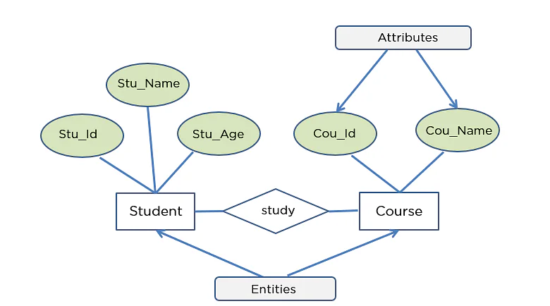
Entity Relationship Diagram

Slide 11
Entity Relationship Diagram
ER diagrams are popular because
they provide an overview of the problem to be addressed.
the view is relatively stable when changes are made to the problem's requirements.
ER diagram is likely to be used to model a problem early in the requirements process.

Slide 12
Class Diagram
Class Diagram is a type of static structure diagram that describes the structure of a system by showing the system's classes, their attributes, operations (or methods), and the relationships among objects.
Components:
Objects: akin to entities, organized in classes.
Attributes: object's variables or characteristics.
Behaviours: actions on the object's variables.

Slide 13
Types of Relationship
Association: Represents static relationship between classes.
Dependency: Represents dependency of one class on another class.
Aggregation: Represents has-a relationship. Contained class does not have strong dependency on container class.
Composition: Contained class has a strong dependency on container class.
Generalization: Represents is-a relationship. It has superclass and subclass relationships

Slide 14
Identifying Classes
External Entities (producers, consumers)
Things
Occurrences or events
Roles
Organizational Units
Places
Structures

Slide 15
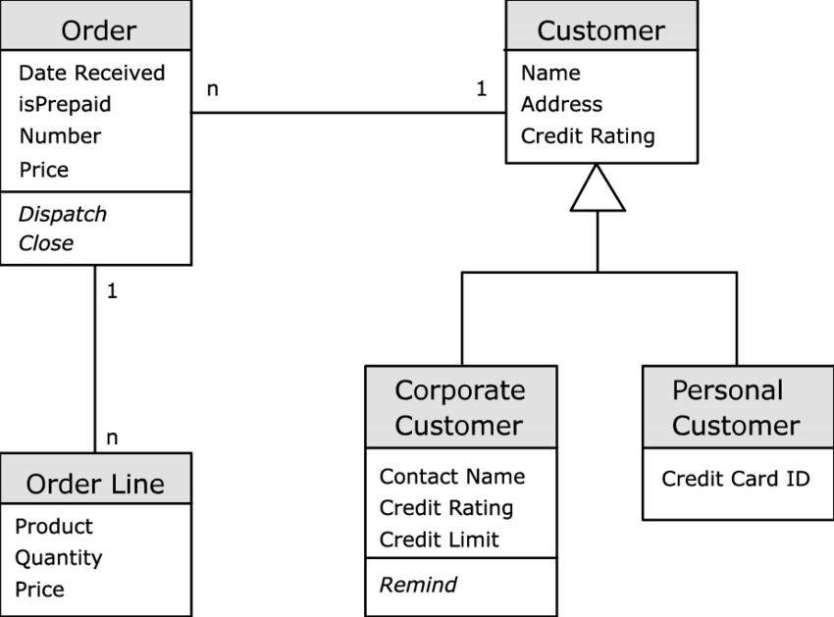
Class Diagram
Association
Class Name
Attributes
Generalization
Behavior

Slide 16
Class-Responsibility-Collaborator Modeling
Class-responsibility-collaborator (CRC) modeling provides a simple means for identifying and organizing the classes that are relevant to system or product requirements.
A CRC model can be viewed as a collection of index cards.
Each index card contains a list of responsibilities on the left side and the corresponding collaborations that enable the responsibilities to be fulfilled on the right side.
Responsibilities are the attributes and operations that are relevant for the class.
Collaborators are those classes that provide a class with the information needed or action required to complete a responsibility.

Slide 17
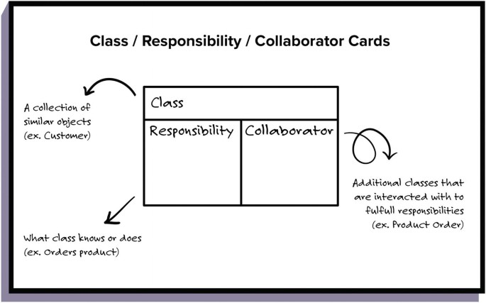
Class-Responsibility-Collaborator Modeling

Slide 18
Class-Responsibility-Collaborator Modeling
Collaborations: Classes fulfill their responsibilities in one of two ways:
A class can use its own operations to manipulate its own attributes, thereby fulfilling a responsibility itself
A class can collaborate with other classes.
Collaborations are identified by determining whether a class can fulfill each responsibility itself. If it cannot, then it needs to interact with another class.

Slide 19
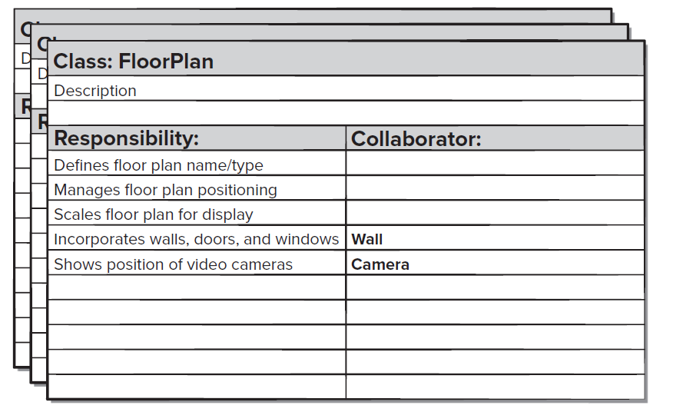
Class-Responsibility-Collaborator Modeling

Slide 20
Class-Responsibility-Collaborator Modeling
Once a complete CRC model has been developed, the representatives from the stakeholders can review the model using the following approach [Amb95]:
All participants in the review (of the CRC model) are given a subset of the CRC model index cards. No reviewer should have two cards that collaborate.
The review leader reads the use case deliberately. As the review leader comes to a named object, she passes a token to the person holding the corresponding class index card.
When the token is passed, the holder of the class card is asked to describe the responsibilities noted on the card. The group determines whether one (or more) of the responsibilities satisfies the use case requirement.
If an error is found, modifications are made to the cards. This may include the definition of new classes (and corresponding CRC index cards) or revising lists of responsibilities or collaborations on existing cards.

Slide 21
State Diagram
A graphical description of all dialog between the system and its environment.
Node (state) represents a stable set of conditions that exists between event occurrences
Edge (transition) represents a change in behaviour or condition due to the occurrence of an event
Useful both for specifying dynamic behaviour and for describing how behaviour should change in response to the history of events that have already occurred.

Slide 22
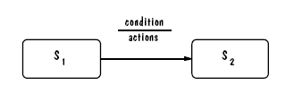
State Diagram: UML Notation

Slide 23
State Diagram: UML Statechart
Statechart diagrams provide us an efficient way to model the interactions or communication that occur within the external entities and a system.
These diagrams are used to model the event-based system.
A UML model is a collection of concurrently executing statecharts.
UML statechart diagram have a rich syntax, including state hierarchy, concurrency, and inter-machine communication.

Slide 24
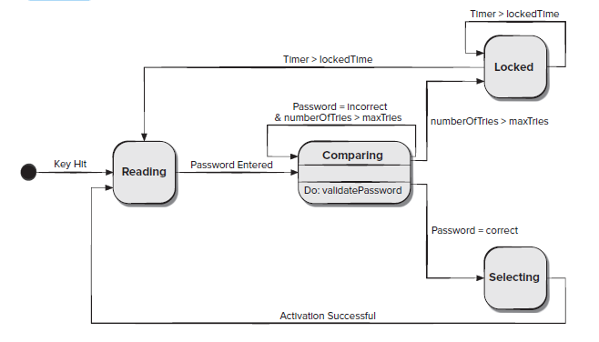
State Diagram(Control Panel)
[
]
[
]
[
]
[
]
[
]

Slide 25
Sequence Diagram
A sequence diagram simply depicts interaction between objects in a sequential order, the order in which these interactions take place.
Sequence diagrams describe how and in what order the objects in a system function.

Slide 26

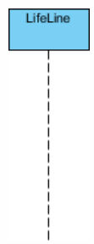
Sequence Diagram Notations
Actor:
Represent roles played by human users, external hardware, or other subjects.
Lifeline:
A lifeline represents an individual participant in the interaction.

Slide 27
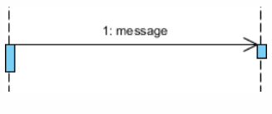
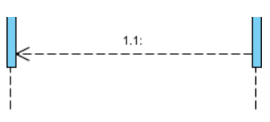
Sequence Diagram Notations
Call Message:
It defines a particular communication between the lifelines of an interaction, which represents that the target lifeline has invoked an operation.
Return Message:
It defines a particular communication between the lifelines of interaction that represent the flow of information from the receiver of the corresponding caller message.

Slide 28
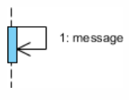
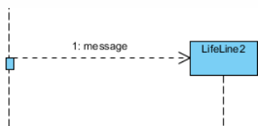
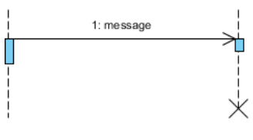
Sequence Diagram Notations
Self Message:
It describes a communication, particularly between the lifelines of an interaction that represents a message of the same lifeline, has been invoked.
Create Message:
It describes a communication, particularly between the lifelines of an interaction describing that the target (lifeline) has been instantiated.
Destroy Message:
It describes a communication, particularly between the lifelines of an interaction that depicts a request to destroy the lifecycle of the target.

Slide 29
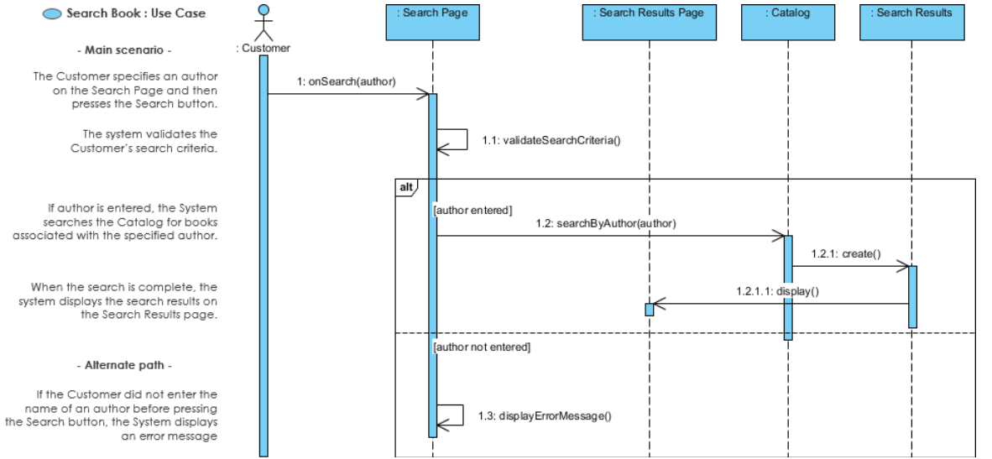

Slide 30
Swimlane Diagrams
A swim lane diagram is a type of flowchart that defines who does what in a process.
Using the metaphor of lanes in a pool, a swim lane diagram provides clarity and accountability by placing process steps within the horizontal or vertical “swimlanes” of a particular employee, work group or department.
It shows connections, communication and handoffs between these lanes, and it can serve to highlight waste, redundancy and inefficiency in a process.

Slide 31
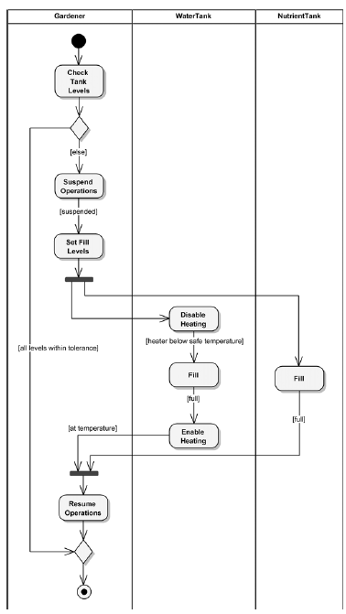

Slide 32
Petri Nets
A form of state-transition notation that is used to model concurrent activities and their interaction
Circles (places) represent activities or conditions
Bars represents transitions
Arcs connect a transition with its input places and its output places
The places are populated with tokens, which act as enabling conditions for the transitions
Each arc can be assigned a weight that specifies how many tokens are removed from arc's input place, when the transition fires

Slide 33
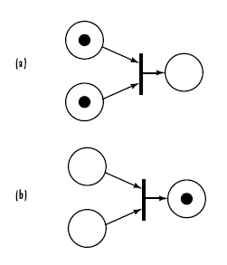
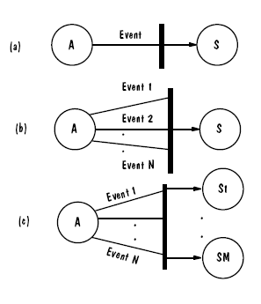
Petri Nets
A transition is enabled if each of its input places contains enough tokens to contribute its arc’s weight’s worth of tokens, should the enabled transition actually fire.
Tokens
Three types of transitions

Slide 34
Petri Nets
Concurrent entities are synchronized whenever their activities, or places, act as input places to the same transition.
This synchronization ensures that all of the pre-transition activities occur before the transition fires but does not constrain the order in which these activities occur.
These features of concurrency and synchronization are especially useful for modeling events whose order of occurrence is not important.

Slide 35
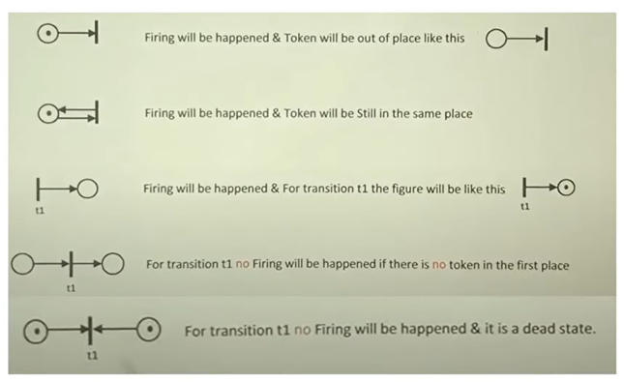
Petri Nets

Slide 36
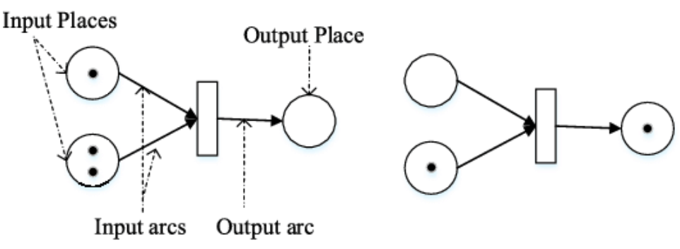
Petri Nets
A transition with multiple input places requires tokens in all of its input places before it can fire and produce a token in an output place.

Slide 37
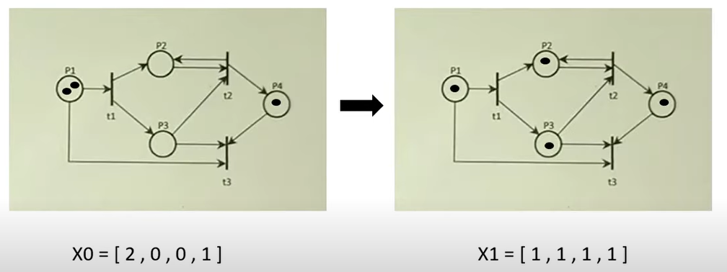
Petri Nets (Example)

Slide 38
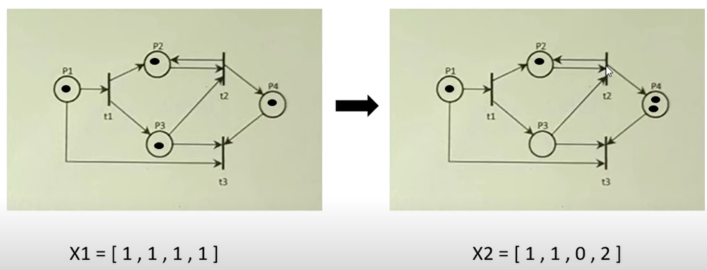
Petri Nets (Example)

Slide 39
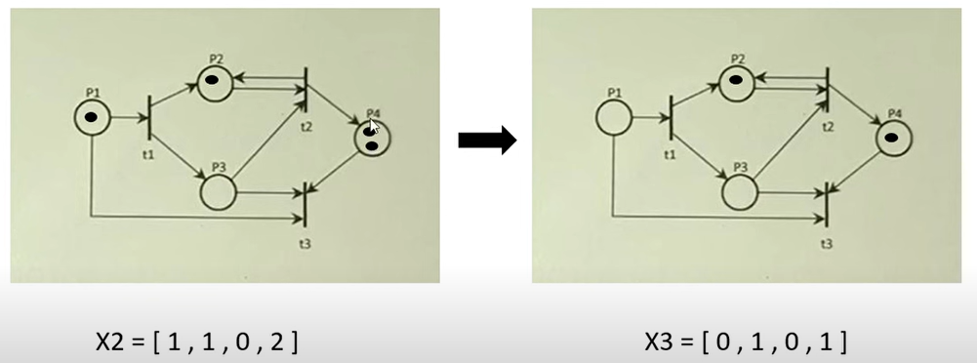
Petri Nets (Example)

Slide 40
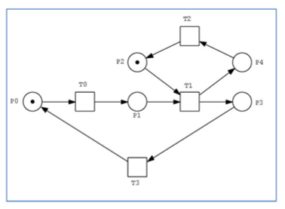
Example

Slide 41
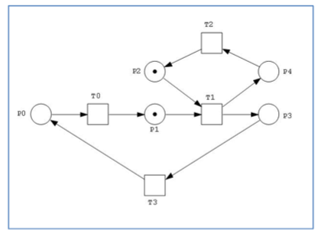
Example

Slide 42
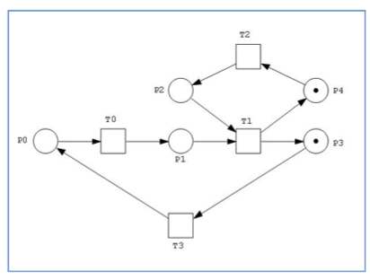
Example

Slide 43
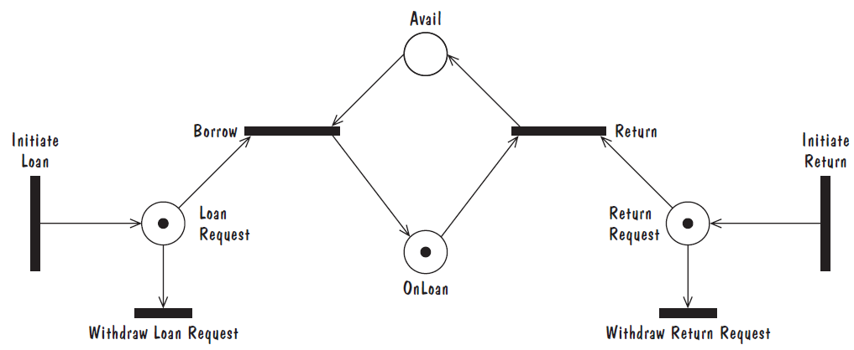
Petri Nets
Petri net of book loan

Slide 44
References
Roger S. Pressman, Software Engineering A Practitioner’s Approach, 9th Edition. McGrawHill
Shari PFleeger, Joanne Atlee, Software Engineering: Theory and Practice, 4th Edition
Roger S. Pressman, Software Engineering A Practitioner’s Approach, 5th Edition. McGrawHill

